Slide 1
EE_735 Assignment_3
3/09/2017

Slide 2
Numerical solution of PN junction diode
Parameter values are same as given in assignment problem.
Lets denote total device length by L cm.
Lets divide L into N nodes. Let h be the spacing between two consecutive nodes. h=L/(N). (h=L/(N-1)) will also do.
Our aim is to solve : ΔV = - J\F . These terms have been described in the additional material.
Lets try to derive matrix representation of J and F.
Note: The simulation results are shown for abrupt junction case only.

Slide 3
Terms and their meaning
V - potential profile; Vt = kT/q is the thermal voltage; n – electron concentration; p - hole concentration; ni - intrinsic carrier concentration; Nd -donor dopant concentration; Na - acceptor dopant concentration; Ndop – net doping profile; φn = Vt * log(Nd/ni); φp = Vt * log(Na/ni); ε = 12 * ε₀ (where ε₀ is the permittivity of vacuum).
P side
V
N side
φn
node1
V=0
Nodes
-φp
V((N/2)+1)
node N
Some V profiles which can be used as an initial guess
V(N/2)
V
node1
φn
V=0
Nodes
-φp
node N
node N/2

Slide 4
Doping profile
Abrupt junction
Ndop
Ndop(1)
P side
N side
Nd
Ndop(2)
node1
Ndop=0
Nodes
.
.
.
-Na
Ndop((N/2)+1)
Ndop =
node N
Ndop(N/2)
Ndop
node1
Nd
Ndop=0
Nodes
Ndop(N)
-Na
node N
node N/2
Nx1
Linearly graded junction

Slide 5
V, n and p
V (1)
ni*exp(V (1)/Vt)
ni*exp(-V (1)/Vt)
V (2)
ni*exp(V (2)/Vt)
ni*exp(-V (2)/Vt)
V =
.
.
.
n =
.
.
.
p =
.
.
.
V (N)
ni*exp(V (N)/Vt)
ni*exp(-V (N)/Vt)
Nx1
Nx1
Nx1

Slide 6
b matrix
Ndop(1)+p(1)-n(1)
p(1)/(-Vt)-n(1)/Vt
Ndop(2)+p(2)-n(2)
p(2)/(-Vt)-n(2)/(Vt)
.
.
.
.
Ndop(N/2)+p(N/2)-n(N/2)
p(N/2)/(-Vt)-n(N/2)/Vt
Ndop((N/2)+1)+p((N/2)+1)-n((N/2)+1)
p((N/2)+1)/(-Vt)-n((N/2)+1)/Vt
ρ = q *
; Δρ = q *
.
.
.
.
Ndop(N-1)+p(N-1)-n(N-1)
p(N-1)/(-Vt)-n(N-1)/Vt
Ndop(N)+p(N)-n(N)
p(N)/(-Vt)-n(N)/Vt
Nx1
Nx1
b = -(ρ/ε) ; Δb=-(Δρ/ε)

Slide 7
F matrix and boundary conditions
V(1)- b(1)
(V(1)-2*(V(2))+V(3))/h²- b(2)
(V(2)-2*(V(3))+V(4))/h²- b(3)
b(1) = V(1) and b(N) = V(N) ;
where V(1) and V(N) are fixed potentials.
Δb(1) = 0 and Δb(N) = 0;
F=
.
.
.
(V(N-3)-2*(V(N-2))+V(N-1))/h²- b(N-2)
These are the Boundary conditions and shouldn’t change during subsequent iterations.
(V(N-2)-2*(V(N-1))+V(N))/h²- b(N-1)
V(N) - b(N)
Nx1

Slide 8
Jacobian matrix (J)
Columns
1
2
3
4
N-2
N-1
N
1
1-Δb(1)
0
0
0
0
0
0
2
-2/h² -Δb(2)
1/h²
. . .
1/h²
0
0
0
0
-2/h² -Δb(3)
1/h²
. . .
0
1/h²
0
0
0
.
.
.
rows
0
. . .
-2/h² -Δb(N-2)
1/h²
N-2
0
0
1/h²
0
N-1
0
0
0
. . .
1/h²
-2/h² -Δb(N-1)
1/h²
0
N
0
. . .
0
0
0
0
0
1-Δb(N)
NxN

Slide 9
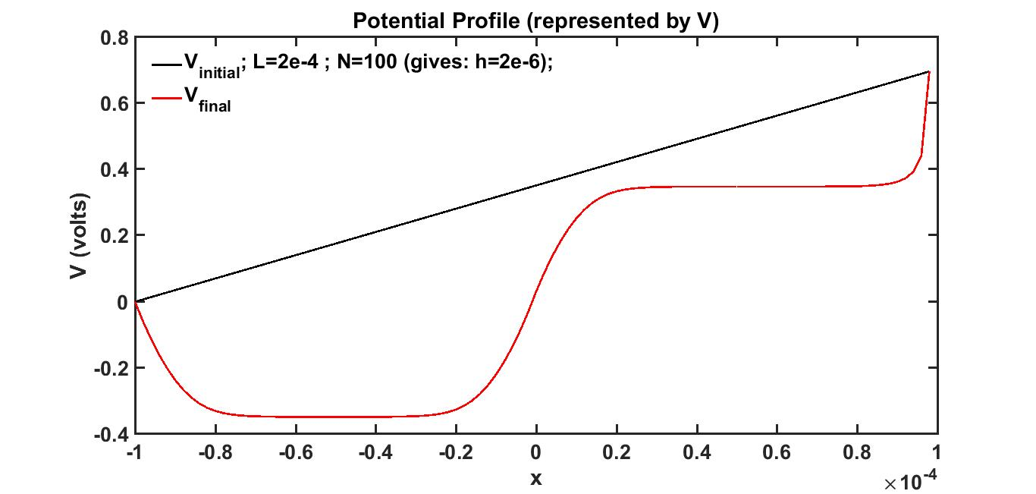
Simulation results
There is a problem at the boundaries. We have used p=ni * exp(-V/Vt). We have fixed V(1)=0, which yields p(1)=ni. However p(1) = Na, since it belongs to the bulk. Thus this boundary condition is not satisfying hole concentration in the bulk. Similar reasoning can be given for n. (Note : x < 0 is P type and x > 0 is N type). It took around 40 iterations to converge. h=L/N has been used.

Slide 10
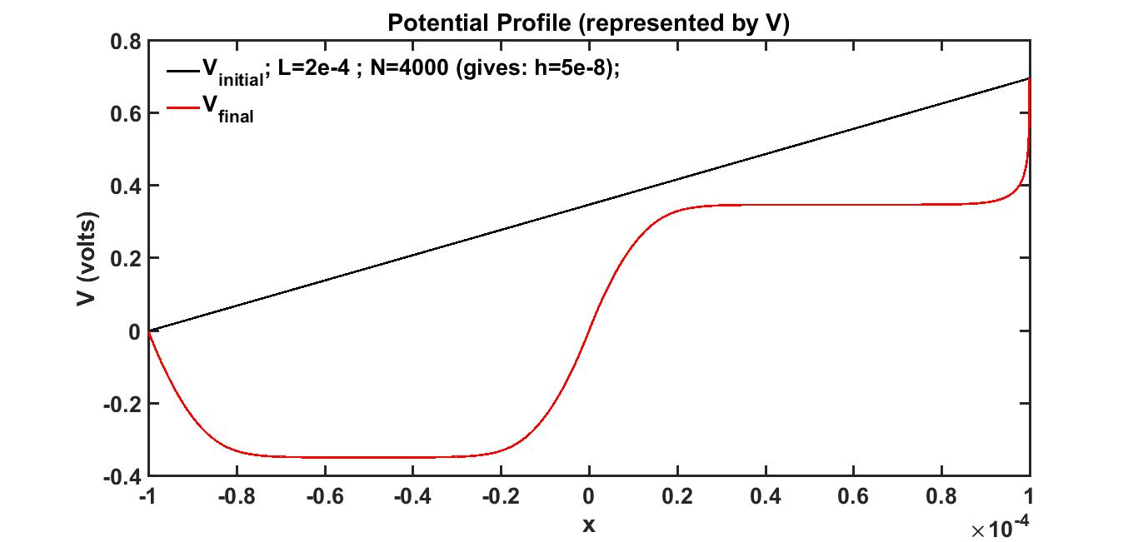
Simulation results
This graph is similar to the previous one. Here we have reduced the step size ‘h’ by increasing the number of node points ‘N’. Thus varying h within the range 1e-8 cm to 1e-6 cm did not result in convergence issues. h=L/N has been used.

Slide 11
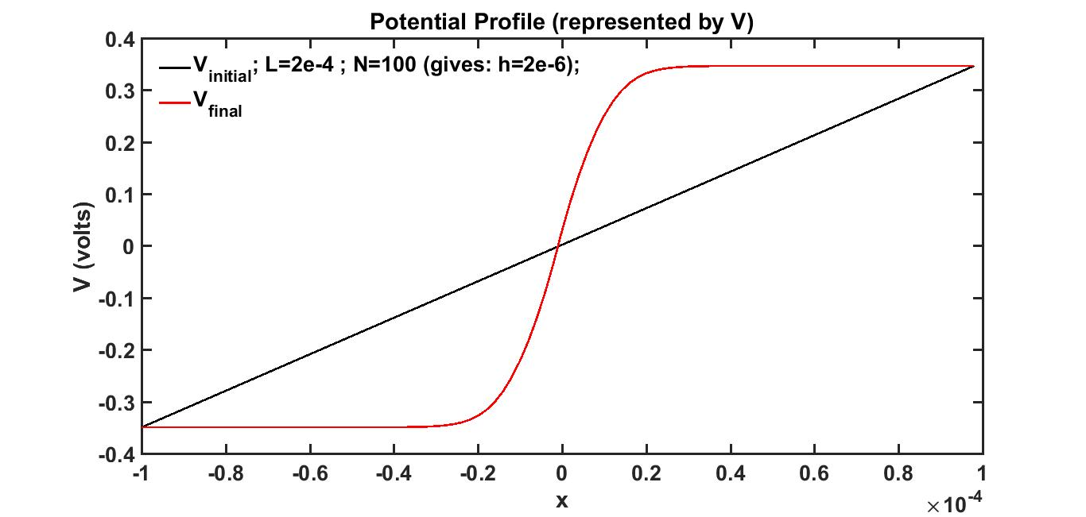
Simulation results
We have fixed V(1)=-φp and V(N)=φn, which yield correct values for n and p at the boundaries. It took around 50 iterations to converge. h=L/N has been used.

Slide 12
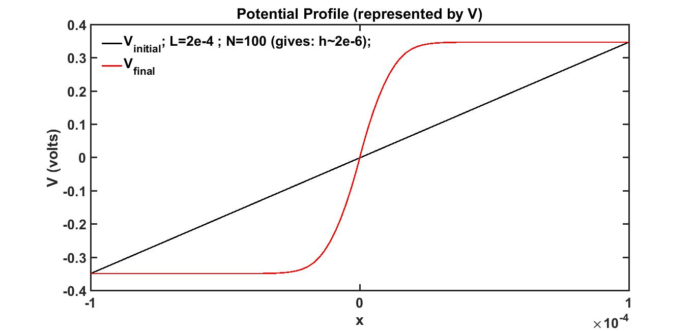
Simulation results
This graph is same as the previous one. h=L/(N-1) has been used.

